Slide 1
DTS205TC High Performance Computing
Lecture 2 Infrastructure 2
Di Zhang, Spring 2024

Slide 2
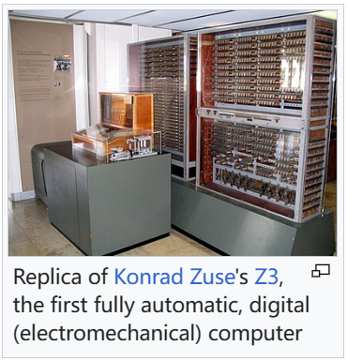
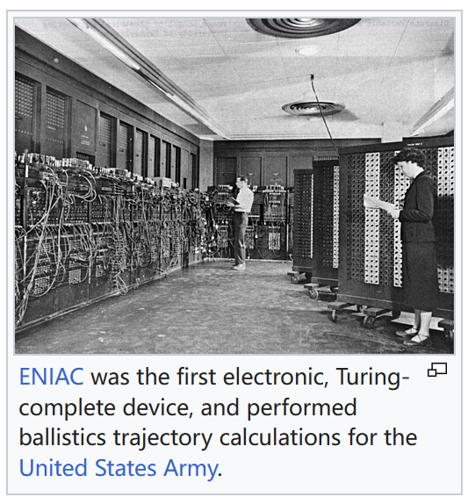
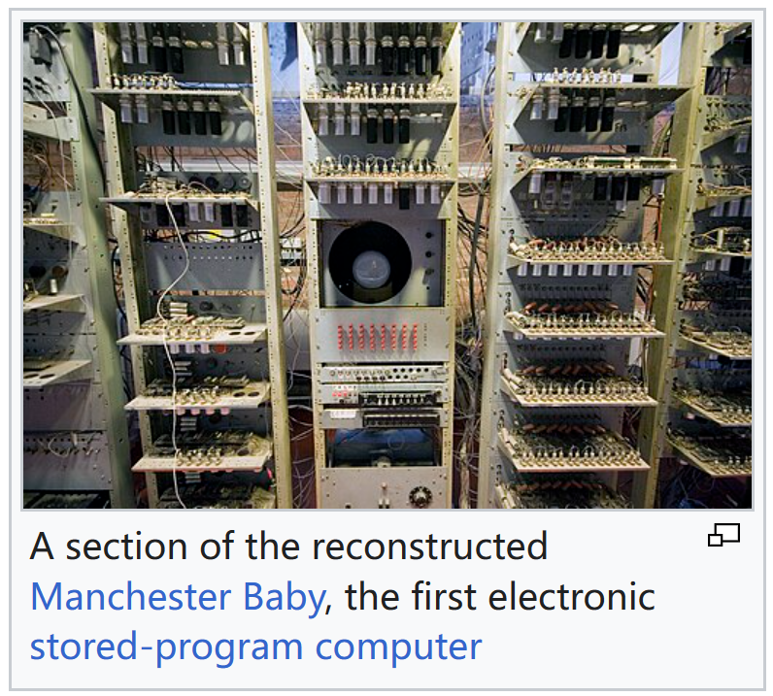
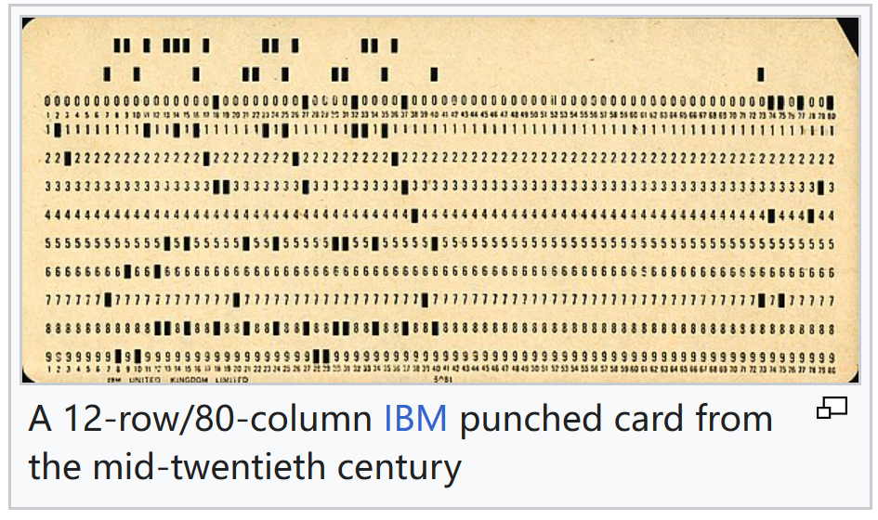
History of computers
1941, Germeny
1945, US
1948, UK

Slide 3
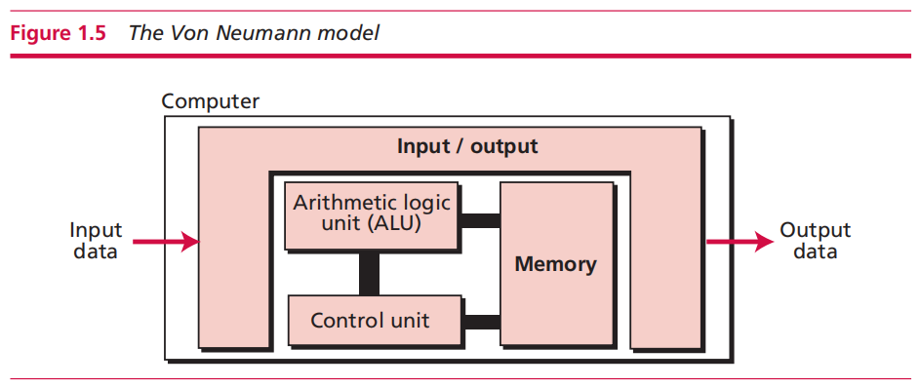
Von Neumann Model
Programs must be stored
Sequential execution of instructions

Slide 4
Components
ALU
Memory
Control unit
Input / output

Slide 5
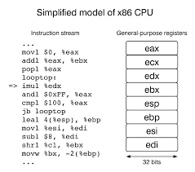
*Turing and Von Neumann
A set of fixed instructions or a programming language is enough

Slide 6
Demo
https://peterhigginson.co.uk/lmc/?F5=12-Feb-24_14:04:09
https://justine.lol/ape.html

Slide 7
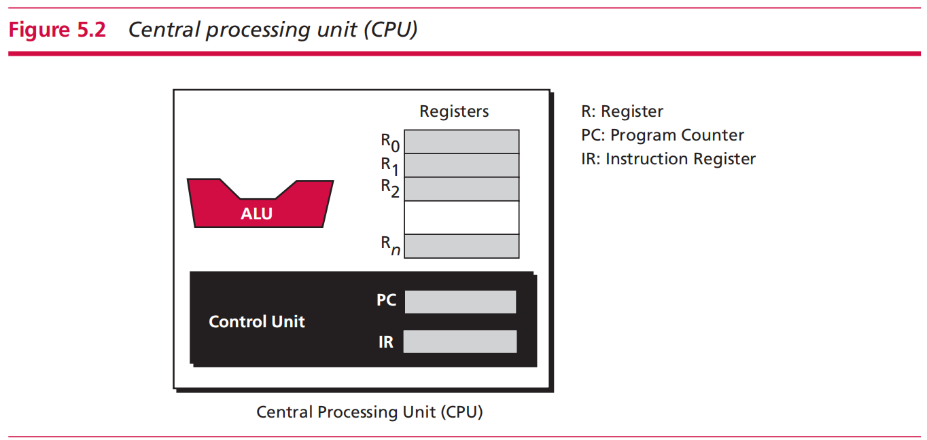
Central processing unit (CPU)

Slide 8
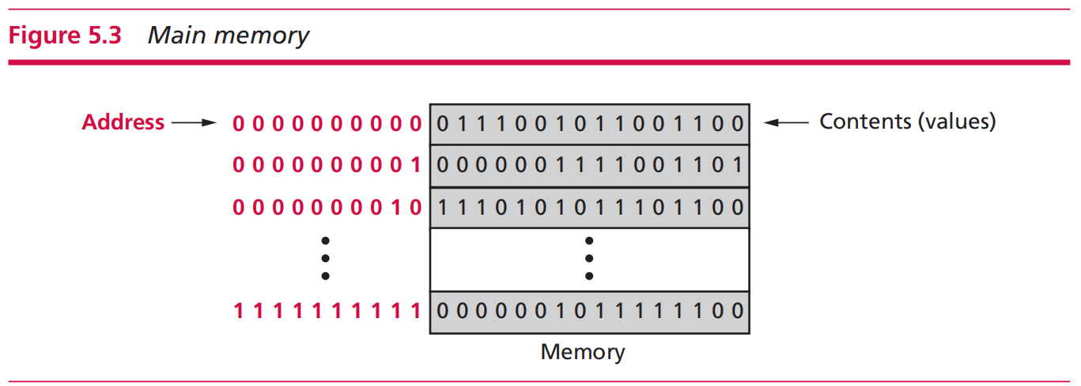
Main memory

Slide 9
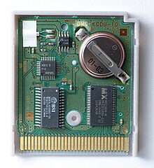
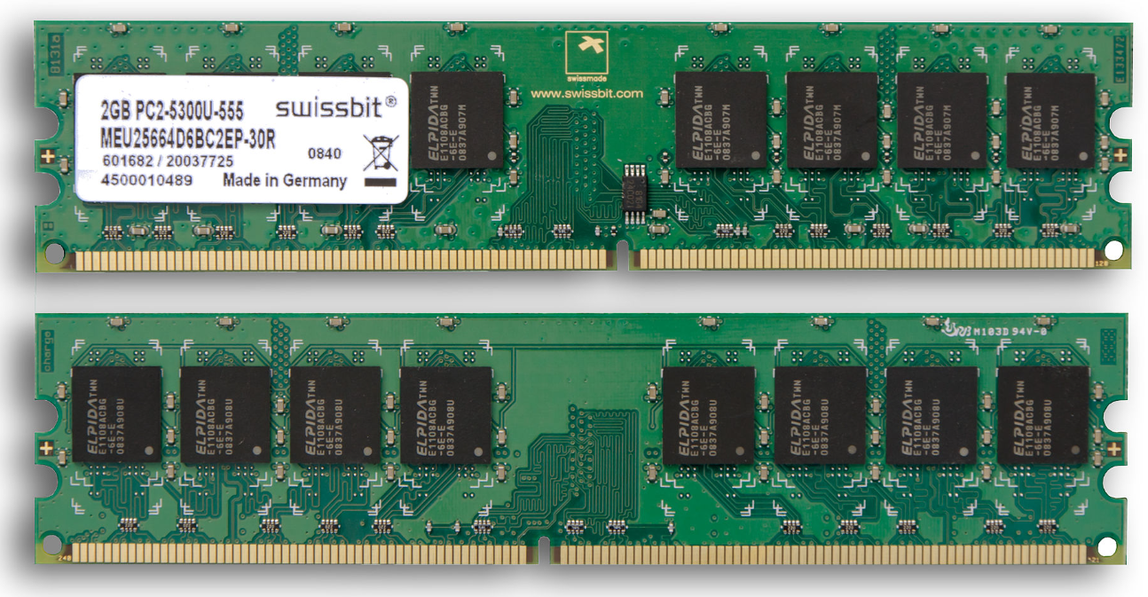
Memory types
ROM
RAM

Slide 10
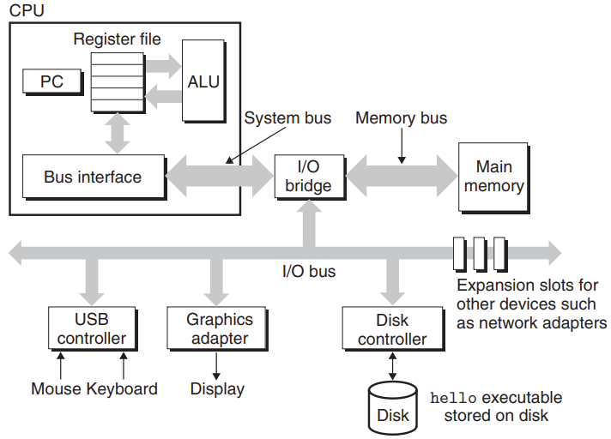
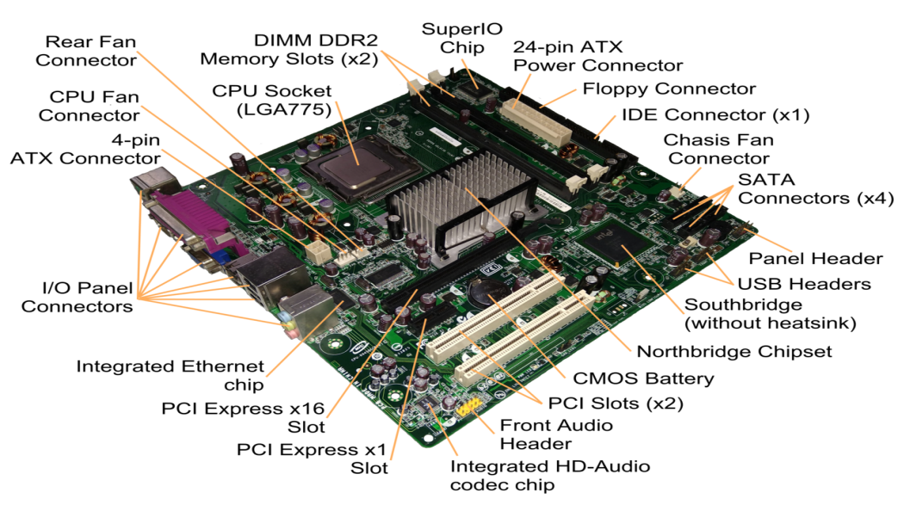

Structure of computer
von neumann architecture
The main components (review of 103) :
CPU
I/O
Memory
Graphic card
Intel D945GCCR
Doom: PC Graphics Benchmark
Notes:
If you disassemble a computer case, you can see something like this
like a traffic policeman, or a traffic light
so that they do not collide
It is responsible for converting the binary image into blinking pixels on the LCD screen
It can run cool effects on those low-configuration machines

Slide 11
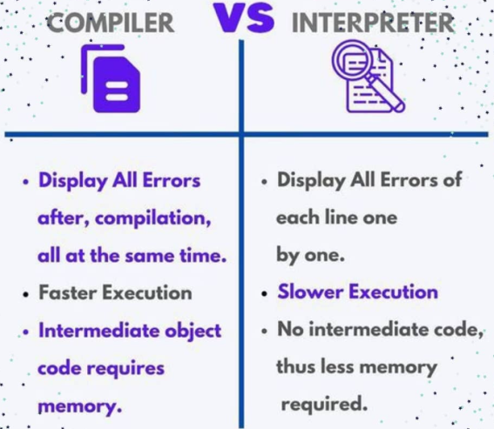
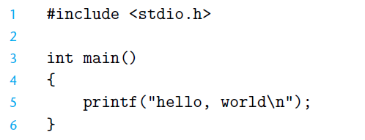
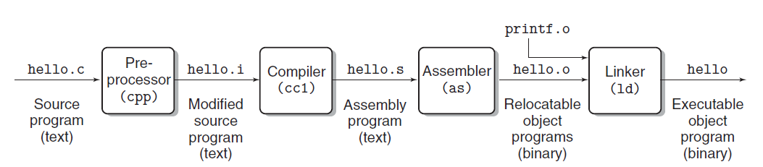
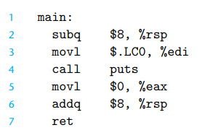
Example: Hello world
Dealing with
#include
Q: Anyone knows differences between C and Python?

Slide 12
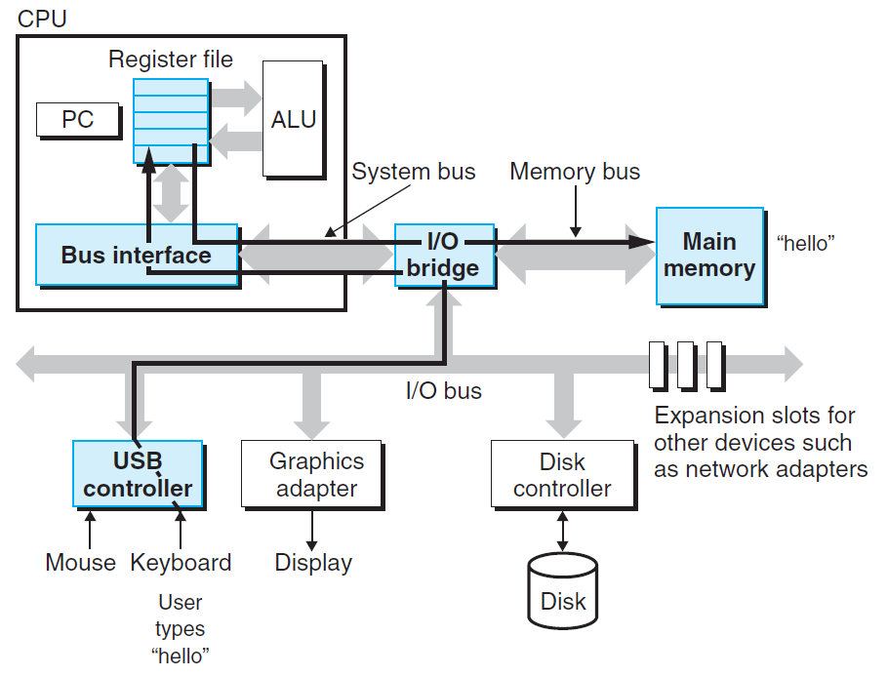
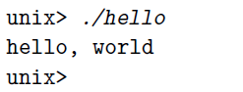
Example: Hello world
1. Shell reads the hello command into memory from the keyboard.

Slide 13
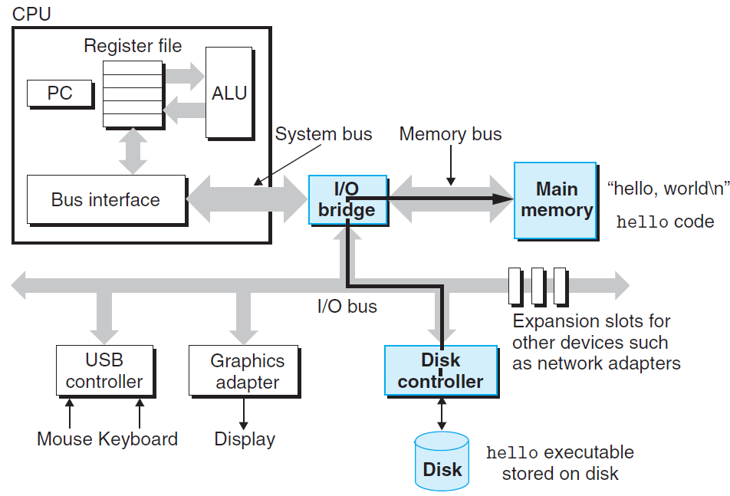
Example: Hello world
2. OS loads the executable from disk into main memory.

Slide 14
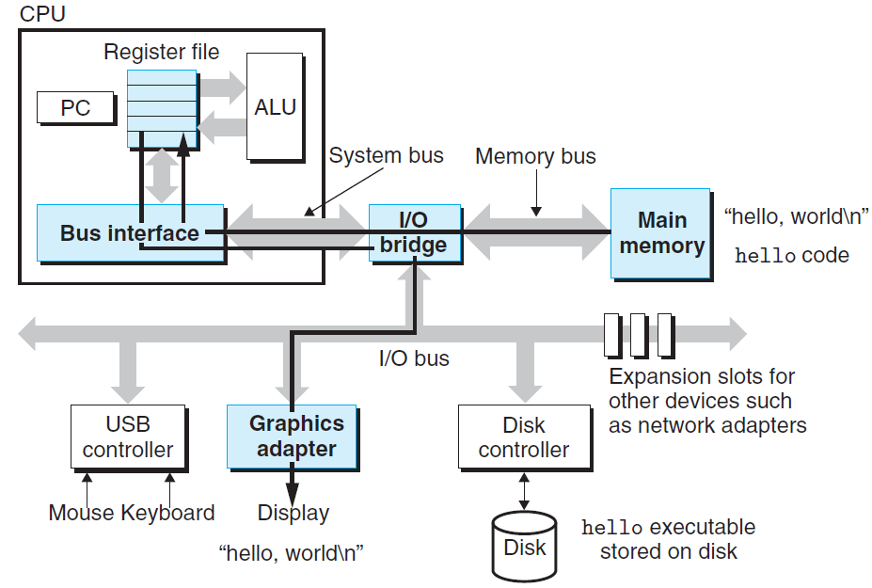
Example: Hello world
3. The OS prepares the program, which then executes itself and writes the output string from memory to the display.

Slide 15
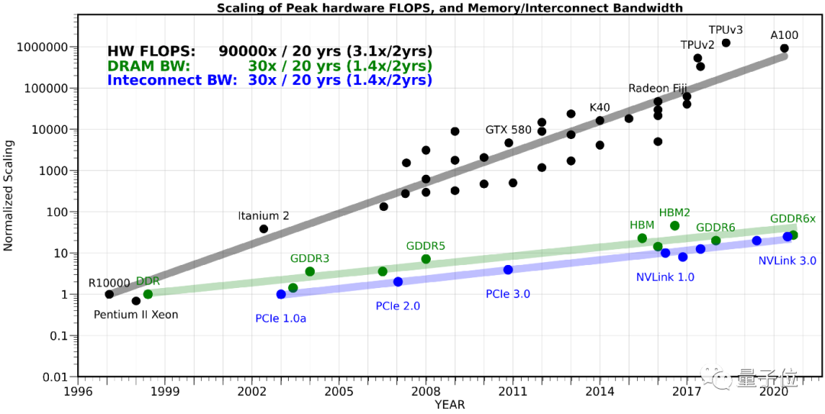
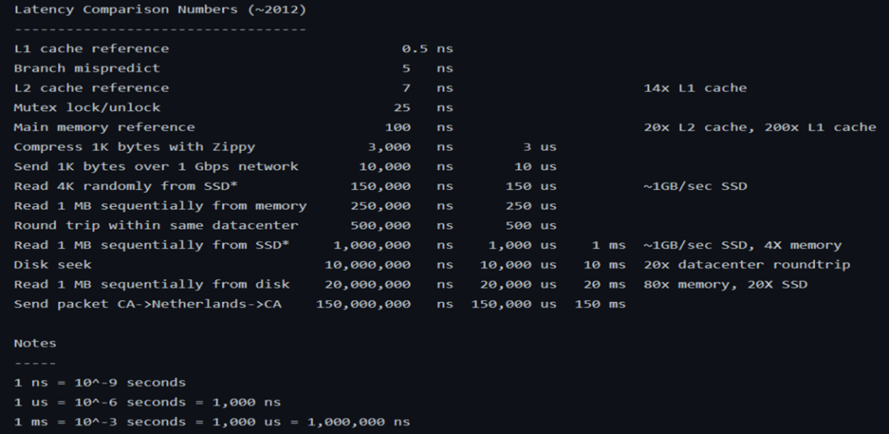


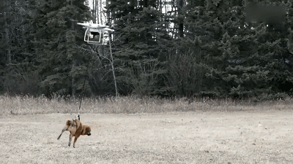
Speed Mismatch: Memory Wall
GFLOPS=Giga (10^9) Floating-point Operations Per Second
Problem: In order to read and write data, the CPU must wait for the memory
An Example of Speed Mismatching
Notes:
and the gap between them is widening
The computing speed of the cpu has been soaring

Slide 16
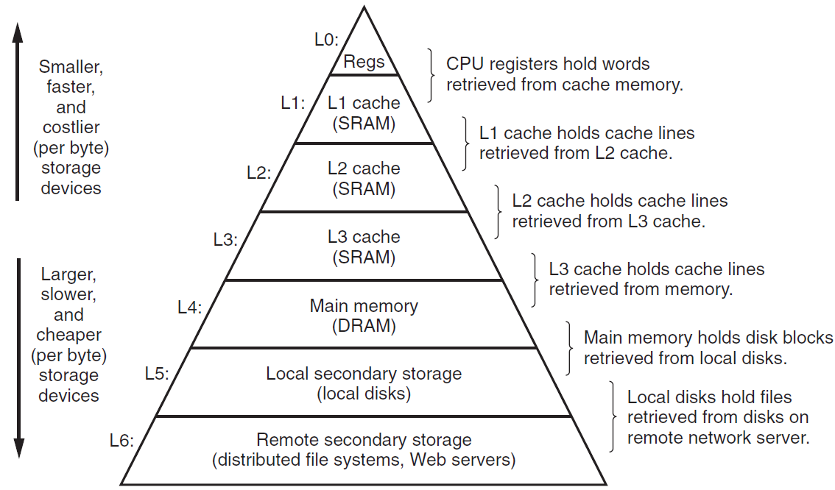
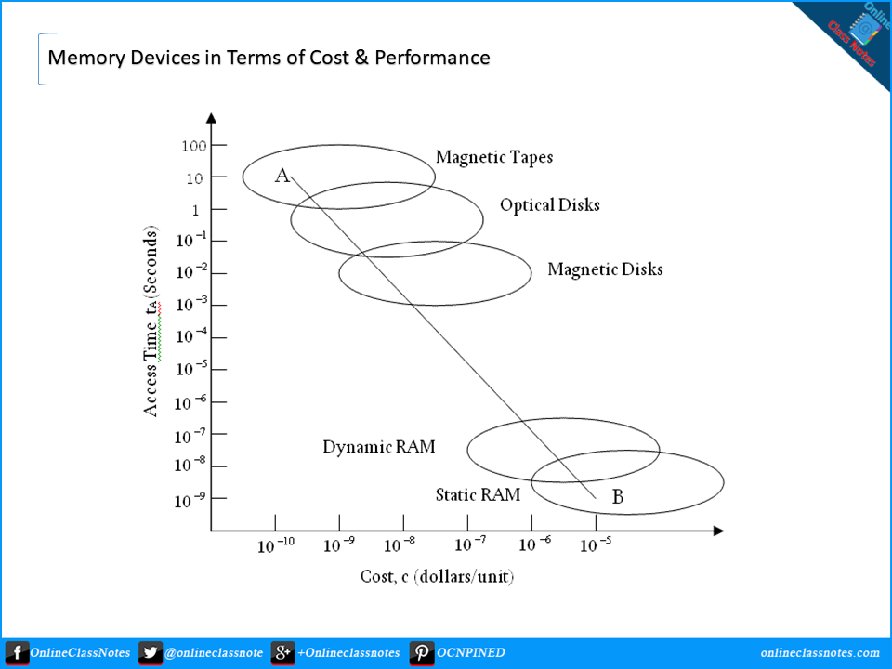
Caches matter
They can be cache at bottom!
One Time
CPU
Many Times
Register
Main Memory
Register: fast but expensive
The role of cache: play the role of agent; based on the principle of locality, it can speed up the visiting
Hierarchical cache system: Multi-Level Acceleration
Notes:
To alleviate this problem

Slide 17
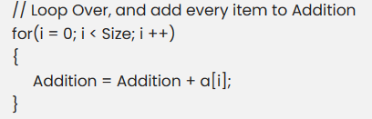
Example: Summing 1-D Arrays
Consider summing an array ‘int a[N]’
It requires N-1 additions, as well as 2*(N-1) reads and N-1 writes
To estimate running time, in classic algorithm theory (ref. 203), we only count the number of operations
However, if the read and write time is a hundred times the calculation time, then it must be considered
Without cache, it needs cycle time:
N-1 + 100* 3*(N-1)
With cache and have all data put into it
N-1 + 0.5* 3*(N-1)
When N=10,000, the latter is 0.0083 (<1%) of the former!

Slide 18
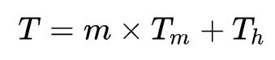
Cache Policy
CPU
Cache
Memory
A Policy needs to be defined to keep the access to Memory in the cache as much as possible
m：cache miss rate
T_{m}: memory access time
T_{h}: cache access time
→ the lower m the better

Slide 19
First In First Out (FIFO)
Data Addr.
A | B | B | E | F | B | C | B | E
A | A | A | E | E | E | E | E | E
B | B | B | B | F | F | F | F | F
C | C | C | C | C | B | B | B | B
D | D | D | D | D | D | C | C | C
Missing rate = 4/9
Always replace the earliest entry in the cache
This part will be Lab 1

Slide 20
Least recently used (LRU)
Data Addr.
A | B | B | E | F | B | C | B | E
A(0) | A | A | A | A | A | C(7) | C | C
B(-3) | B(2) | B(3) | B | B | B(6) | B | B(8) | B
C(-2) | C | C | E(4) | E | E | E | E | E(9)
D(-1) | D | D | D | F(5) | F | F | F | F
Missing rate = 3/9
This strategy requires keeping a "date of birth" for cache lines and tracking the "least recently used" (oldest) cache line based on it
The difference between LRU and FIFO is that Processor's access to a record will update its "date of birth", while FIFO does not

Slide 21
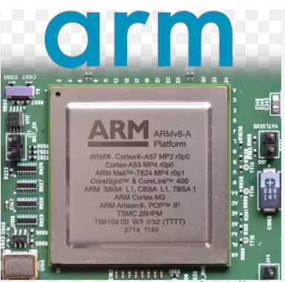
Random Replacement Policy
Steps:
If the cache is not full, save the most recently accessed data in the cache
If it is full, replace one of them at random.
Simple and stable, once used in ARM processors

Slide 22
Other Policies
LIFO
More policies can be found:
https://en.wikipedia.org/wiki/Cache_replacement_policies

Slide 23
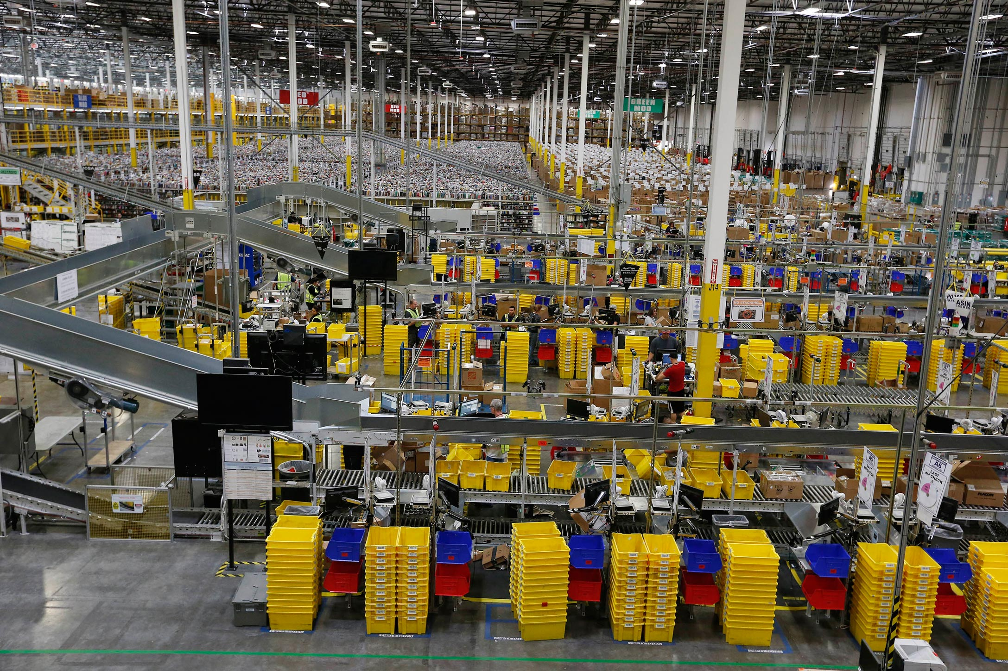
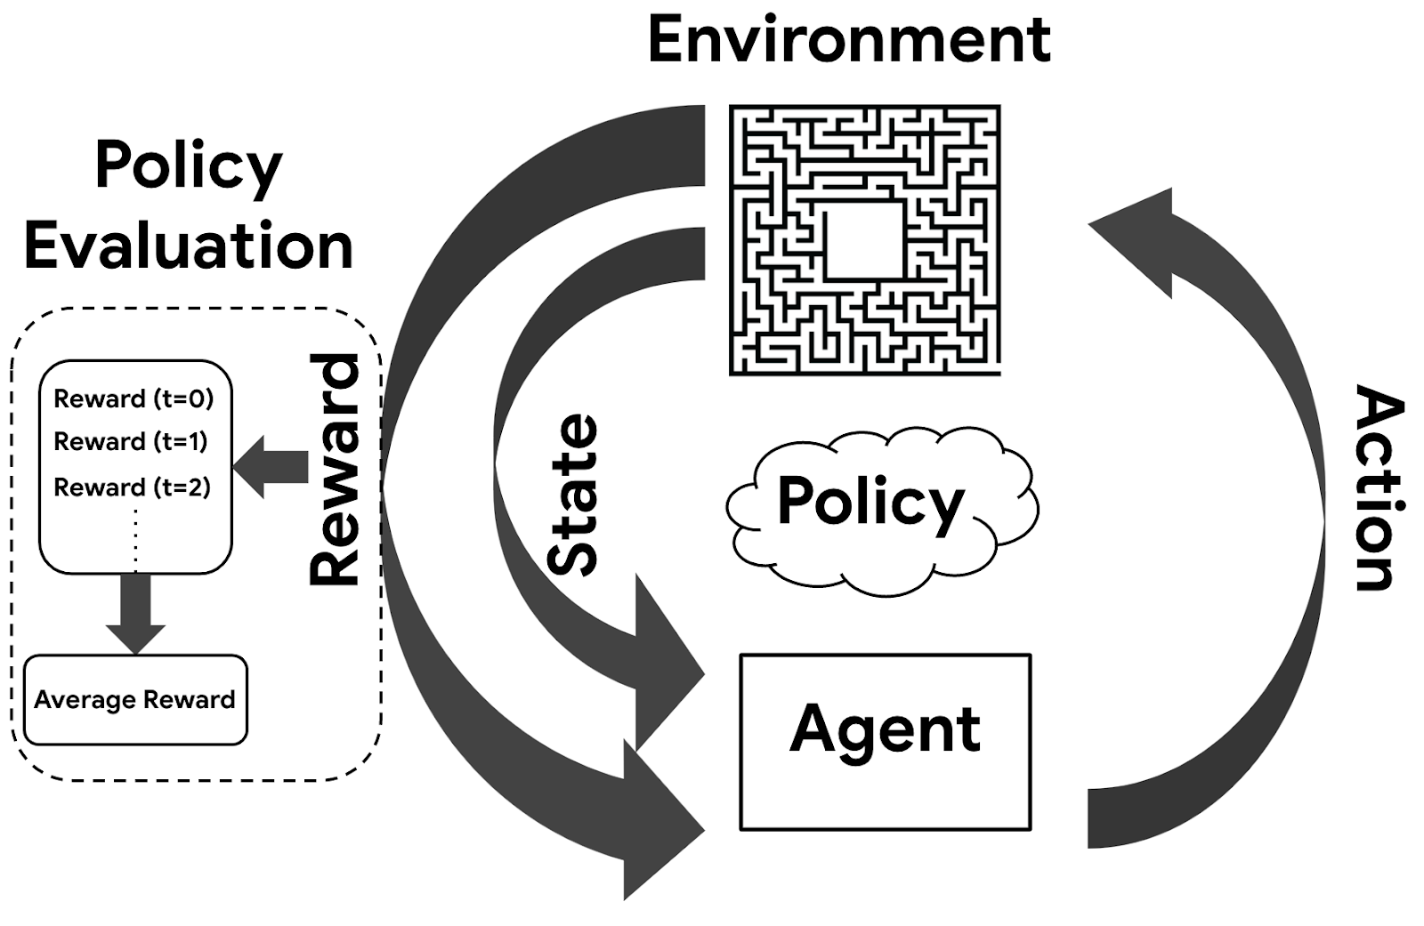
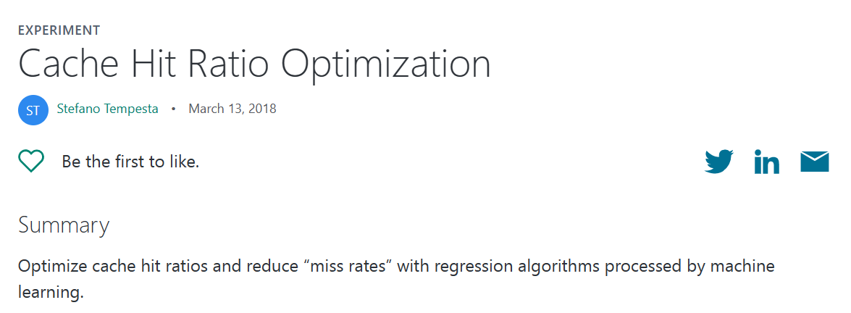
Further Reading
Cache is everywhere
Web Content
Video Broadcast
Logistic/warehousing
Can it be solved by ML? Yes.
Amazon Logistics
Policy in Reinforcement Learning

Slide 24
Performance optimization
Choose the right algorithm and data structure
Go to Course 203
Choose the right language (C is usually the fastest, but also hard to maintain)
Go to Course 102
Choose compiler
icc vs gcc
gcc compiler option –O3
For python, switch to Cython
Loop optimization
Code movement: extract repeated calculations out of the loop

Slide 25
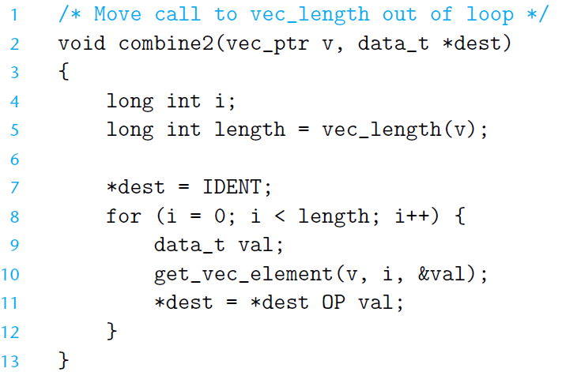
Performance optimization (serial)
Pay attention to the implicit loop: the linked list must traverse itself when finding the length

Slide 26
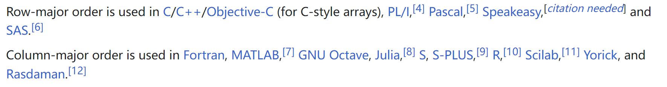
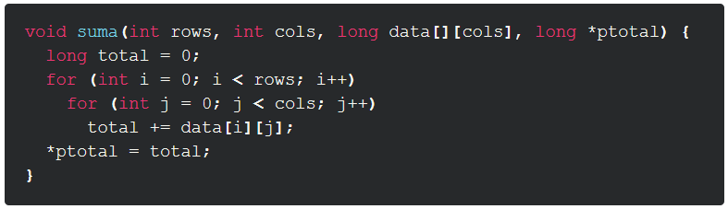
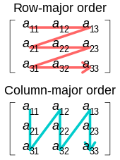
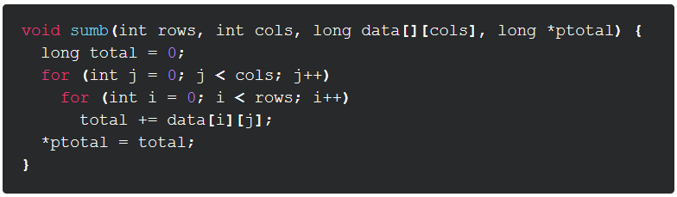
Performance optimization
Write temporary variables inside the loop instead of global variables - compiler can put temporary variables completely in registers without writing back to memory
For two-dimensional arrays, traverse in major order, not minor order

Slide 27
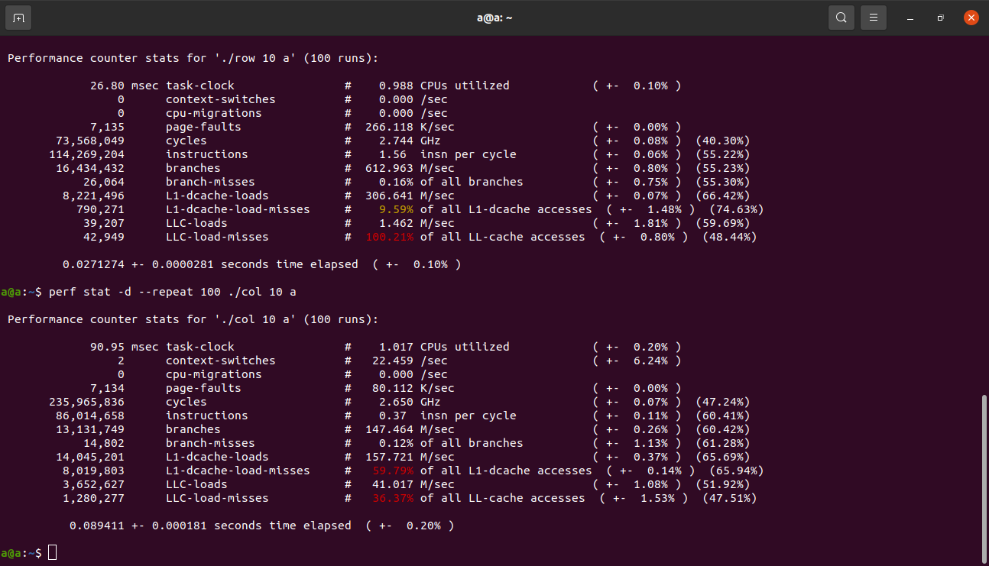
Performance optimization (serial)
CPU has a prefetch mechanism based on locality!

Slide 28
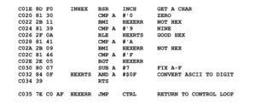
Performance optimization
Function call
Minimize the function call in the loop, or replace it with #define in C or C++ template
Specify register
C++ register variables
Data type
Reduce floating point operations, replace with integers
The final choice:
Switch to Assembly, if you can!

Slide 29
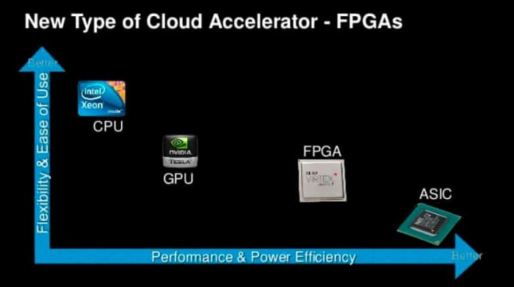
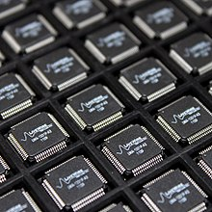
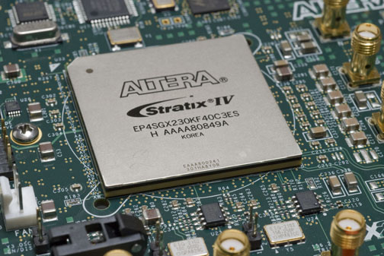
Further Reading
application-specific integrated circuit
What is the fastest way to speed up an algorithm?
Abandoning the von Neumann architecture
Sacrifice Generality for Specialized Acceleration: from CPU to ASIC
Example: summing 10,000-length array
A circuit supporting 10,000 inputs + 1 output
Field-programmable gate array
Notes:
ˈsərkət

Slide 30
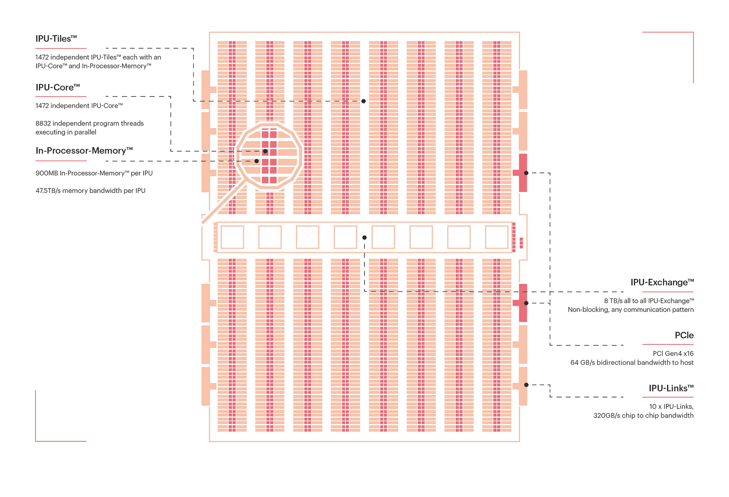
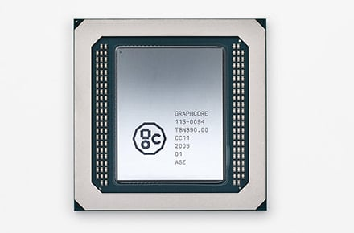
Frontier
Intelligence Processing Unit @ Graphcore
Design for Deep Learning:
Non-von Neumann architecture
125 Tflops@120W
45TB/s Memory Bandwidth

